Slide 1
Introduction of Generative Adversarial Network (GAN)
Notes:
Q: 可以做得很好? 為什麼?
Q: VAE 為何不好?
Q: unroll GAN有用嗎？

Slide 2
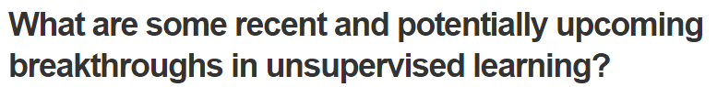
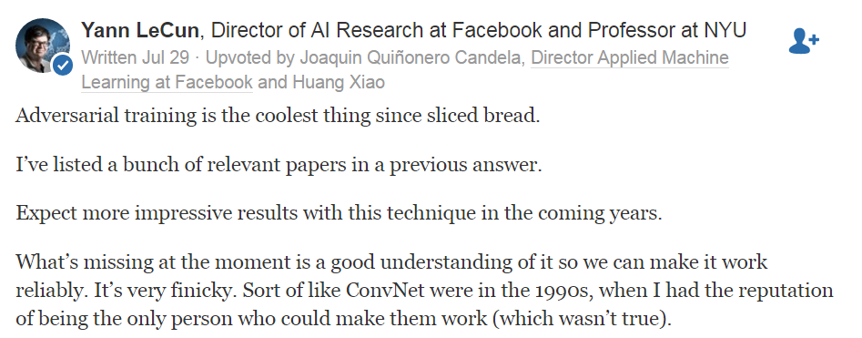
Yann LeCun’s comment
https://www.quora.com/What-are-some-recent-and-potentially-upcoming-breakthroughs-in-unsupervised-learning

Slide 3
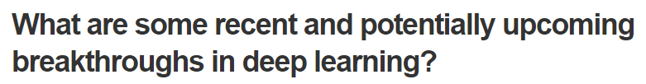
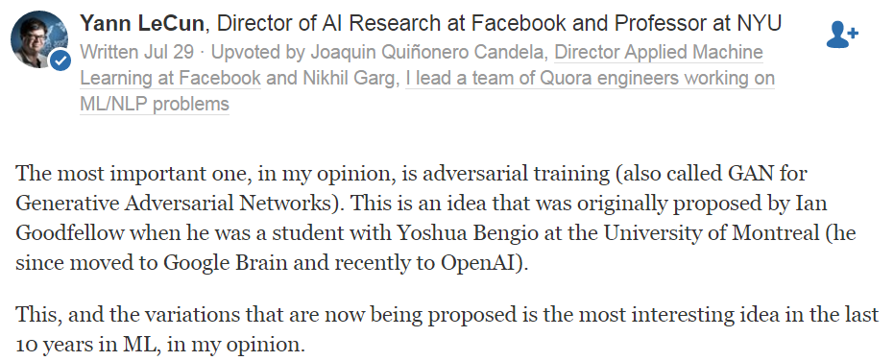
Yann LeCun’s comment
……
https://www.quora.com/What-are-some-recent-and-potentially-upcoming-breakthroughs-in-deep-learning

Slide 4
Outline
Basic Idea of GAN
GAN as structured learning
Can Generator learn by itself?
Can Discriminator generate?
A little bit theory

Slide 5



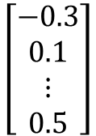
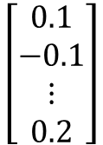
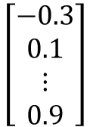
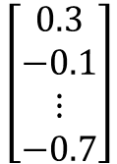
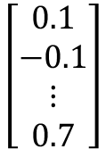
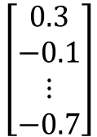
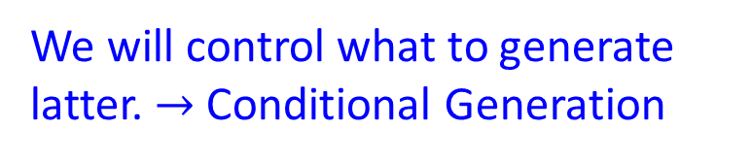
Generation
We will control what to generate latter. $→$ Conditional Generation
Image Generation
$$\left[\begin{aligned}0.3 \\ −0.1 \\ ⋮ \\ −0.7\end{aligned}\right]$$
$$\left[\begin{aligned}0.1 \\ −0.1 \\ ⋮ \\ 0.7\end{aligned}\right]$$
$$\left[\begin{aligned}−0.3 \\ 0.1 \\ ⋮ \\ 0.9\end{aligned}\right]$$
NN
Generator
In a specific range
Sentence Generation
$$\left[\begin{aligned}0.3 \\ −0.1 \\ ⋮ \\ −0.7\end{aligned}\right]$$
$$\left[\begin{aligned}0.1 \\ −0.1 \\ ⋮ \\ 0.2\end{aligned}\right]$$
$$\left[\begin{aligned}−0.3 \\ 0.1 \\ ⋮ \\ 0.5\end{aligned}\right]$$
NN
Generator
How are you?
Good morning.
Good afternoon.

Slide 6
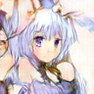



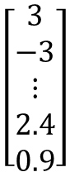
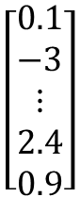
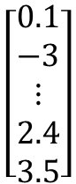
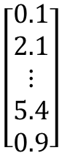
Basic Idea of GAN
Powered by: http://mattya.github.io/chainer-DCGAN/
It is a neural network (NN), or a function.
Generator
high dimensional vector
image
vector
$$\left[\begin{aligned}0.1 \\ −3 \\ ⋮ \\ 2.4 \\ 0.9\end{aligned}\right]$$
$$\left[\begin{aligned}3 \\ −3 \\ ⋮ \\ 2.4 \\ 0.9\end{aligned}\right]$$
Generator
Generator
Each dimension of input vector represents some characteristics.
Longer hair
$$\left[\begin{aligned}0.1 \\ 2.1 \\ ⋮ \\ 5.4 \\ 0.9\end{aligned}\right]$$
$$\left[\begin{aligned}0.1 \\ −3 \\ ⋮ \\ 2.4 \\ 3.5\end{aligned}\right]$$
Generator
Generator
blue hair
Open mouth

Slide 7

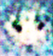
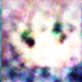
Basic Idea of GAN
It is a neural network (NN), or a function.
Discri-minator
scalar
image
Larger value means real, smaller value means fake.
Discri-minator
Discri-minator
1.0
1.0
Discri-minator
Discri-minator
0.1
0.1

Slide 8
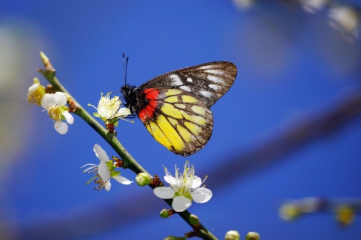
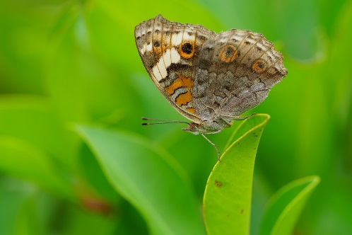
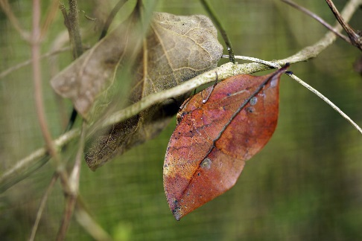
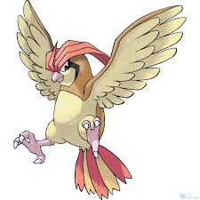
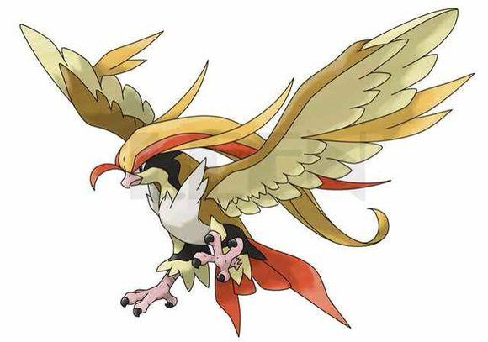
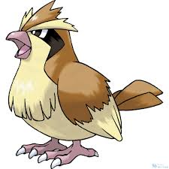
Basic Idea of GAN
Generator
Brown
veins
Butterflies are not brown
Butterflies do not have veins
……..
Discriminator

Slide 9
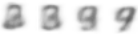
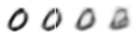
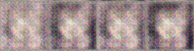
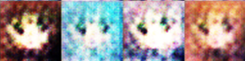
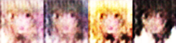

Basic Idea of GAN
This is where the term “adversarial” comes from.
You can explain the process in different ways…….
NN
Generator
v1
NN
Generator
v2
NN
Generator
v3
Discri-minator
v1
Discri-minator
v2
Discri-minator
v3
Real images:

Slide 10
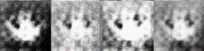
Basic Idea of GAN
Generator
(student)
Discriminator
(teacher)
Generator
v1
Discriminator
v1
没有两个圈
Generator
v2
Discriminator
v2
没有颜色
Generator
v3
为什么不自己学？
为什么不自己做？

Slide 11







Algorithm
G
D
Initialize generator and discriminator
In each training iteration:
Step 1: Fix generator G, and update discriminator D
sample
Update
1
1
1
1
D
generated objects
Database
0
0
0
0
randomly sampled
G
vector
Fix
vector
vector
vector
Discriminator learns to assign high scores to real objects and low scores to generated objects.

Slide 12
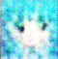
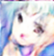
Algorithm
G
D
Initialize generator and discriminator
In each training iteration:
Step 2: Fix discriminator D, and update generator G
Generator learns to “fool” the discriminator
hidden layer
NN
Generator
Discri-minator
0.13
vector
update
fix
Gradient Ascent
large network

Slide 13

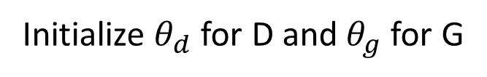
Algorithm
Initialize $θ_{d}$ for D and $θ_{g}$ for G
In each training iteration:
Sample m examples $\left\{x^{1},x^{2},…,x^{m}\right\}$ from database
Sample m noise samples $\left\{z^{1},z^{2},…,z^{m}\right\}$ from a distribution
Obtaining generated data $\left\{{\tilde{x}}^{1},{\tilde{x}}^{2},…,{\tilde{x}}^{m}\right\}$, ${\tilde{x}}^{i}=G\left(z^{i}\right)$
Update discriminator parameters $θ_{d}$ to maximize
$\tilde{V}=\frac{1}{m}\sum_{i=1}^{m}{logD\left(x^{i}\right)}+\frac{1}{m}\sum_{i=1}^{m}{log\left(1−D\left({\tilde{x}}^{i}\right)\right)}$
$θ_{d}←θ_{d}+η∇\tilde{V}\left(θ_{d}\right)$
Sample m noise samples$\left\{z^{1},z^{2},…,z^{m}\right\}$ from a distribution
Update generator parameters $θ_{g}$ to maximize
$\tilde{V}=\frac{1}{m}\sum_{i=1}^{m}{log\left(D\left(G\left(z^{i}\right)\right)\right)}$
$θ_{g}←θ_{g}−η∇\tilde{V}\left(θ_{g}\right)$
Learning
D
Learning
G

Slide 14
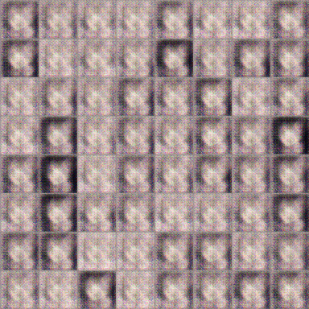
Anime Face Generation
100 updates
Source of training data: https://zhuanlan.zhihu.com/p/24767059

Slide 15
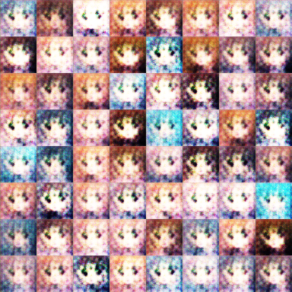
Anime Face Generation
1000 updates

Slide 16
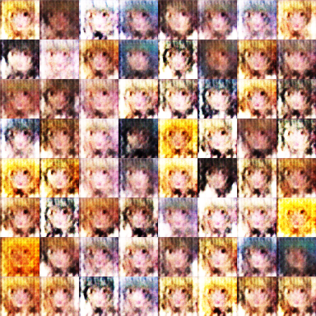
Anime Face Generation
2000 updates

Slide 17
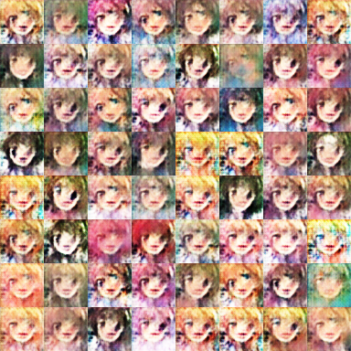
Anime Face Generation
5000 updates

Slide 18
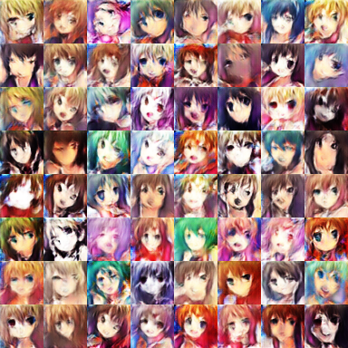
Anime Face Generation
10,000 updates

Slide 19
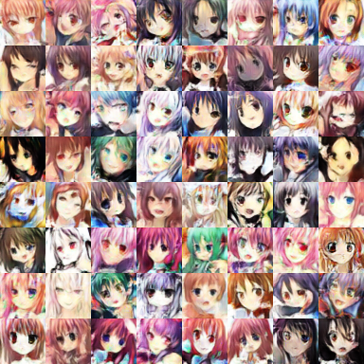
Anime Face Generation
20,000 updates

Slide 20
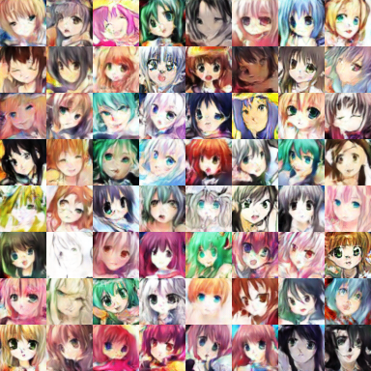
Anime Face Generation
50,000 updates

Slide 21
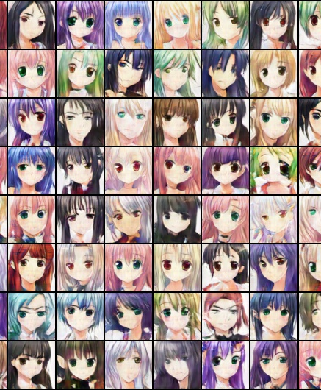
The faces generated by machine.

Slide 22
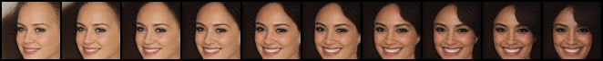

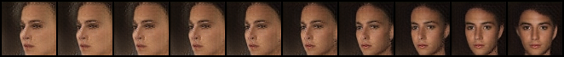
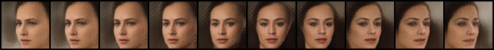
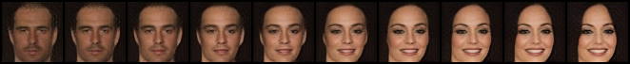
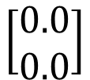
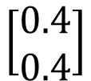
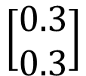
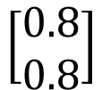






G
G
G
G
G
G
G
G
G
G
$$\left[\begin{aligned}0.0 \\ 0.0\end{aligned}\right]$$
$$\left[\begin{aligned}0.1 \\ 0.1\end{aligned}\right]$$
$$\left[\begin{aligned}0.2 \\ 0.2\end{aligned}\right]$$
$$\left[\begin{aligned}0.3 \\ 0.3\end{aligned}\right]$$
$$\left[\begin{aligned}0.4 \\ 0.4\end{aligned}\right]$$
$$\left[\begin{aligned}0.5 \\ 0.5\end{aligned}\right]$$
$$\left[\begin{aligned}0.6 \\ 0.6\end{aligned}\right]$$
$$\left[\begin{aligned}0.7 \\ 0.7\end{aligned}\right]$$
$$\left[\begin{aligned}0.8 \\ 0.8\end{aligned}\right]$$
$$\left[\begin{aligned}0.9 \\ 0.9\end{aligned}\right]$$

Slide 23
Outline
Basic Idea of GAN
GAN as structured learning
Can Generator learn by itself?
Can Discriminator generate?
A little bit theory

Slide 24
Structured Learning
Machine learning is to find a function f
Regression: output a scalar
Classification: output a “class”
(one-hot vector)
1 | 0 | 0
0 | 1 | 0
0 | 0 | 1
Class 1
Class 2
Class 3
Structured Learning/Prediction: output a sequence, a matrix, a graph, a tree ……
Output is composed of components with dependency

Slide 25

Output Sequence
Machine Translation
“机器学习及其深层与结构化”
“Machine learning and having it deep and structured”
(sentence of language 1)
(sentence of language 2)
Speech Recognition
“感谢大家来上课”
(speech)
(transcription)
Chat-bot
“How are you?”
“I’m fine.”
(what a user says)
(response of machine)

Slide 26






Output Matrix
Image to Image
Colorization:
Ref: https://arxiv.org/pdf/1611.07004v1.pdf
Text to Image
“this white and yellow flower have thin white petals and a round yellow stamen”
ref: https://arxiv.org/pdf/1605.05396.pdf

Slide 27
Why Structured Learning Challenging?
One-shot/Zero-shot Learning:
In classification, each class has some examples.
In structured learning,
If you consider each possible output as a “class” ……
Since the output space is huge, most “classes” do not have any training data.
Machine has to create new stuff during testing.
Need more intelligence

Slide 28
Structured Learning Approach
Generator
Bottom Up
Top
Down
Generative Adversarial Network (GAN)
Learn to generate the object at the component level
Discriminator
Evaluating the whole object, and find the best one

Slide 29
Outline
Basic Idea of GAN
GAN as structured learning
Can Generator learn by itself?
Can Discriminator generate?
A little bit theory

Slide 30












Generator
NN
Generator
code
code
code
vectors
code:
$$\left[\begin{aligned}0.1 \\ −0.5\end{aligned}\right]$$
$$\left[\begin{aligned}0.1 \\ 0.9\end{aligned}\right]$$
$$\left[\begin{aligned}0.2 \\ −0.1\end{aligned}\right]$$
$$\left[\begin{aligned}0.3 \\ 0.2\end{aligned}\right]$$
(where does they come from?)
Image:
As close as possible
NN
Generator
$$\left[\begin{aligned}0.1 \\ 0.9\end{aligned}\right]$$
image

Slide 31


Generator
NN
Generator
code
code
code
vectors
code:
$$\left[\begin{aligned}0.1 \\ −0.5\end{aligned}\right]$$
$$\left[\begin{aligned}0.1 \\ 0.9\end{aligned}\right]$$
$$\left[\begin{aligned}0.2 \\ −0.1\end{aligned}\right]$$
$$\left[\begin{aligned}0.3 \\ 0.2\end{aligned}\right]$$
(where does they come from?)
Image:
Encoder in auto-encoder provides the code ☺
NN
Encoder
$$c$$

Slide 32



Auto-encoder
Low
dimension
Compact representation of the input object
NN
Encoder
code
28 X 28 = 784
Learn together
NN
Decoder
Can reconstruct the original object
code
Trainable
NN
Encoder
NN
Decoder
$$c$$

Slide 33


Auto-encoder
As close as possible
NN
Encoder
NN
Decoder
code
= Generator
Randomly generate a vector as code
NN
Decoder
code
Image
= Generator

Slide 34

What do we miss?
Generated Image
Target
G
as close as possible
It will be fine if the generator can truly copy the target image.
What if the generator makes some mistakes …….
Some mistakes are serious, while some are fine.

Slide 35
What do we miss?
Target
1 pixel error
1 pixel error
我觉得不行
我觉得不行
6 pixel errors
6 pixel errors
我觉得可以
我觉得可以

Slide 36
What do we miss?
Each neural in output layer corresponds to a pixel.
Layer L-1
Layer L
……
empty
……
ink
……
……
……
我觉得不行
我觉得可以
The relation between the components are critical.
Although highly correlated, they cannot influence each other.
Need deep structure to catch the relation between components.

Slide 37
Outline
Basic Idea of GAN
GAN as structured learning
Can Generator learn by itself?
Can Discriminator generate?
A little bit theory

Slide 38
Discriminator
Discriminator is a function D (network, can deep)
Input x: an object x (e.g. an image)
Output D(x): scalar which represents how “good” an object x is
D
D
1.0
0.1
Can we use the discriminator to generate objects?
Yes.

Slide 39
Discriminator
It is easier to catch the relation between the components by top-down evaluation.
我觉得不行
我觉得可以

Slide 40

Discriminator
Suppose we already have a good discriminator D(x) …
Enumerate all possible x !!!
How to learn the discriminator?

Slide 41
Discriminator - Training
I have some real images
D
D
scalar
1
(real)
scalar
1
(real)
D
D
scalar
1
(real)
scalar
1
(real)
Discriminator only learns to output “1” (real).
Discriminator training needs some negative examples.

Slide 42


Discriminator - Training
Negative examples are critical.
D
D
scalar
1
(real)
scalar
1
(real)
D
D
scalar
0
(fake)
scalar
0
(fake)
D
How to generate realistic negative examples?
0.9
Pretty real

Slide 43
Discriminator - Training
General Algorithm
Given a set of positive examples, randomly generate a set of negative examples.
In each iteration
Learn a discriminator D that can discriminate positive and negative examples.
Generate negative examples by discriminator D
v.s.
D

Slide 44
Generator v.s. Discriminator
Generator
Pros:
Easy to generate even with deep model
Cons:
Imitate the appearance
Hard to learn the correlation between components
Discriminator
Pros:
Considering the big picture
Cons:
Generation is not always feasible
Especially when your model is deep
How to do negative sampling?

Slide 45
Generator + Discriminator
General Algorithm
Given a set of positive examples, randomly generate a set of negative examples.
In each iteration
Learn a discriminator D that can discriminate positive and negative examples.
Generate negative examples by discriminator D
v.s.
D
G
=

Slide 46
Benefit of GAN
From Discriminator’s point of view
Using generator to generate negative samples
From Generator’s point of view
Still generate the object component-by-component
But it is learned from the discriminator with global view.
G
=
efficient

Slide 47
Outline
Basic Idea of GAN
GAN as structured learning
Can Generator learn by itself?
Can Discriminator generate?
A little bit theory

Slide 48











Generator
$x$: an image (a high-dimensional vector)
A generator G is a network. The network defines a probability distribution $P_{G}$
$$P_{G}\text{(}\text{x}\text{)}$$
$$P_{data}\left(x\right)$$
Normal Distribution
generator
G
$$z$$
$$x=G\left(z\right)$$
as close as possible
$$G^{∗}=arg\min_{G}{Div\left(P_{G},P_{data}\right)}$$
Divergence between distributions $P_{G}$ and $P_{data}$
How to compute the divergence?

Slide 49




Discriminator
$$G^{∗}=arg\min_{G}{Div\left(P_{G},P_{data}\right)}$$
Although we do not know the distributions of $P_{G}$ and $P_{data}$, we can sample from them.
sample
Database
Sampling from $P_{data}$
sample from normal
G
vector
vector
vector
vector
Sampling from $P_{G}$

Slide 50





Discriminator
$$G^{∗}=arg\min_{G}{Div\left(P_{G},P_{data}\right)}$$
: data sampled from $P_{data}$
Using the example objective function is exactly the same as training a binary classifier.
: data sampled from $P_{G}$
Discriminator
train
Example Objective Function for D
$$V\left(G,D\right)=E_{x∼P_{data}}\left[logD\left(x\right)\right]+E_{x∼P_{G}}\left[log\left(1−D\left(x\right)\right)\right]$$
(G is fixed)
Training:
$$D^{∗}=arg\max_{D}{V\left(D,G\right)}$$

Slide 51

Discriminator
$$G^{∗}=arg\min_{G}{Div\left(P_{G},P_{data}\right)}$$
: data sampled from $P_{data}$
Training:
: data sampled from $P_{G}$
$$D^{∗}=arg\max_{D}{V\left(D,G\right)}$$
Discriminator
train
small divergence
hard to discriminate
(cannot make objective large)
Discriminator
train
large divergence
easy to discriminate

Slide 52



[Goodfellow, et al., NIPS, 2014]
$$G^{∗}=arg\min_{G}{Div\left(P_{G},P_{data}\right)}$$
$$\max_{D}{V\left(G,D\right)}$$
$$D^{∗}=arg\max_{D}{V\left(D,G\right)}$$
Initialize generator and discriminator
In each training iteration:
Step 1: Fix generator G, and update discriminator D
Step 2: Fix discriminator D, and update generator G

Slide 53
The End!

